Slide 1
The impact of molecular profiling of gliomas on treatment and prognosis
Galina Glousker
CAS ADS M3
11.11.24

Slide 2
Molecular biomarkers in glioma

Slide 3

Goal of the project
analyze genomic data from a large cohort of adult patients with glioma
identify genomic alterations associated with clinical behavior and therapy outcome
use machine learning methods to be able to predict glioma outcomes in adult patients depending on their tumor molecular profile

Slide 4
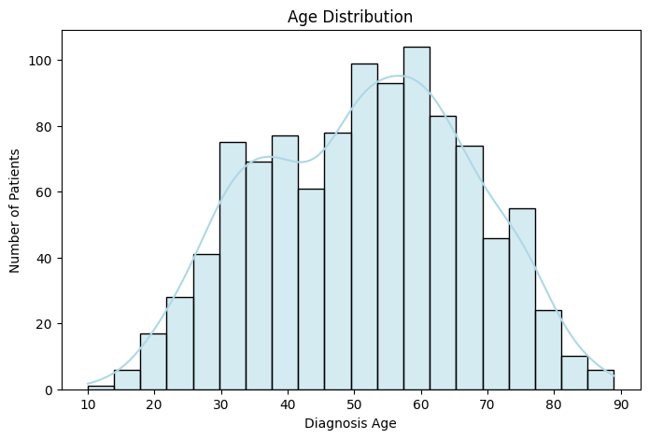
Patient cohort
Total Patient Count: 1047
Sex Distribution: Male 618, Female 429
Neoplasm Histologic Type Distribution: glioblastoma 590, oligodendroglioma 174, astrocytoma 169, oligoastrocytoma 114
Neoplasm Histologic Grade Distribution: G4 590, G3 241, G2 216
Ceccarelli et al., Cell, 2016 http://dx.doi.org/10.1016/j.cell.2015.12.028

Slide 5
Data processing
From the table with sequencing information filter out silent mutations, and identify top 20 mutated genes
Merge the table with sequencing information with the table with clinical information ('Patient ID', 'Diagnosis Age', 'Sex', 'Neoplasm Histologic Grade', 'TMB (nonsynonymous)', 'Pan-Glioma DNA Methylation Cluster’)
Drop NaN

Slide 6
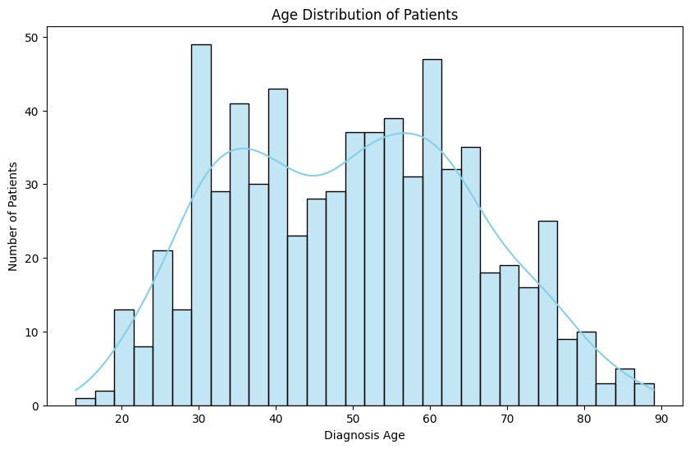
Patient cohort
Total Patient Count: 696
Sex Distribution: Male 405, Female 291
Neoplasm Histologic Type Distribution: glioblastoma 246, oligodendroglioma 170, astrocytoma 167, oligoastrocytoma 113
Neoplasm Histologic Grade Distribution: G4 246, G3 239, G2 211
Ceccarelli et al., Cell, 2016 http://dx.doi.org/10.1016/j.cell.2015.12.028
Notes:
Unsupervised Clustering of Molecular Subtypes
Goal: Discover molecular subtypes of the cancer based on mutation patterns and clinical features.
Features to Use: Hugo_Symbol,Grade, Type, Methylation (one-hot encoded for multiple mutations), Sex, Age and TMB
Approach:Use algorithms like K-Means, Hierarchical Clustering, or DBSCAN for clustering. Apply dimensionality reduction techniques like PCA to visualize the clusters.
Evaluation:Examine how clusters correlate with clinical features such as survival outcomes, IDH status, or WHO Grade

Slide 7
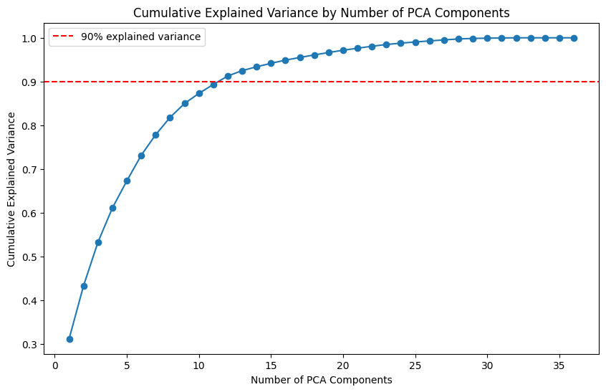
Unsupervised machine learning approach
Decide how many PCs to use for dimensionality reduction
Notes:
PCA before hierarchical clustering

Slide 8
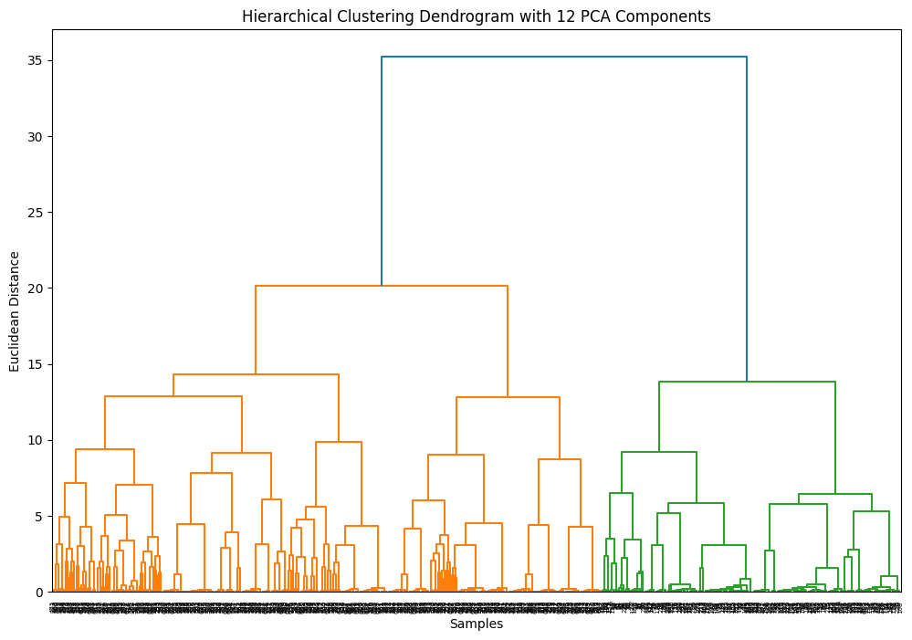
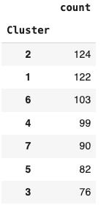
PCA followed by hierarchical clustering
Notes:
Mann WhitneyFrom the dendrogram, a cutoff at a Euclidean distance around 12 seems reasonable, as it separates the branches into several clear clusters.

Slide 9
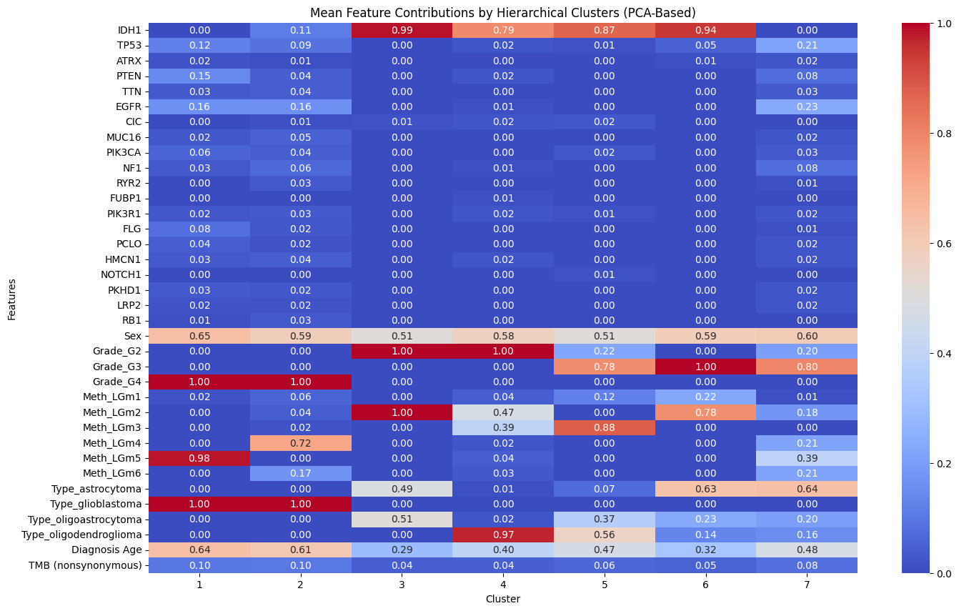
hierarchical clustering, cut off 12

Slide 10
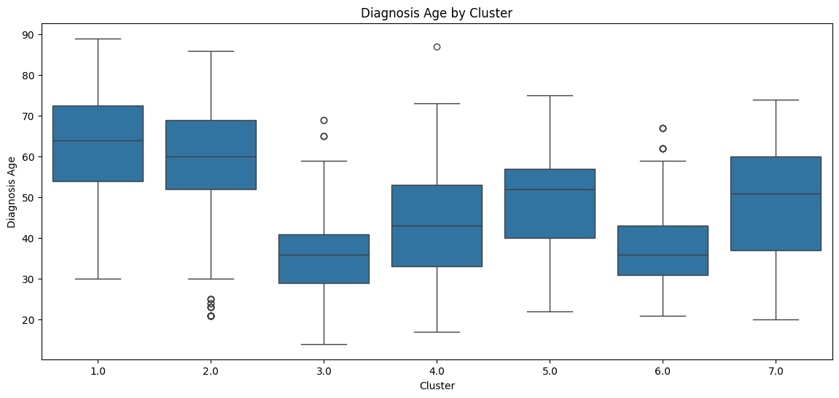
hierarchical clustering, cut off 12

Slide 11
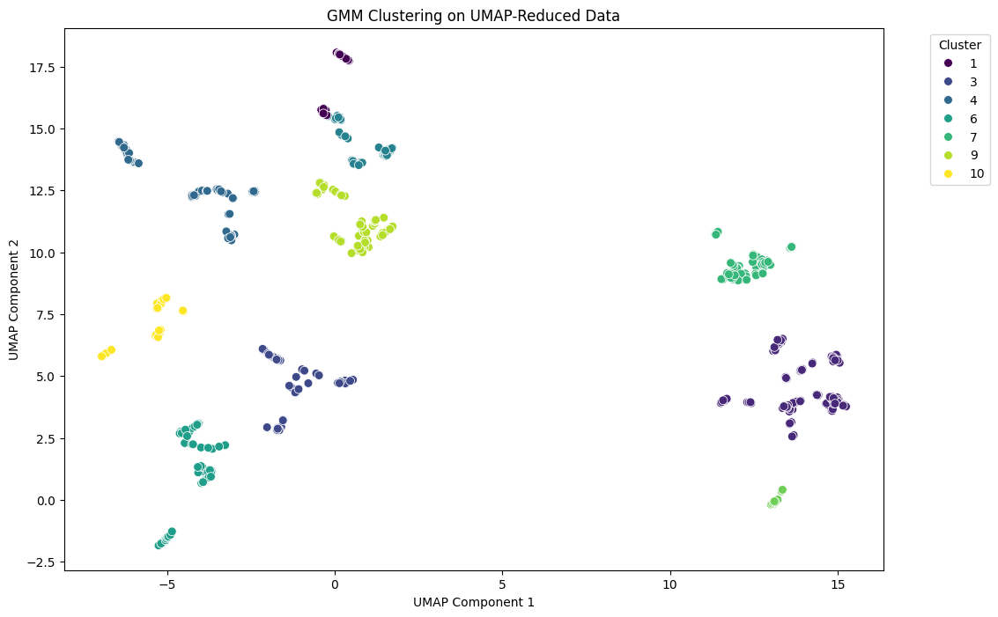
UMAP followed by GMM clustering
GMM Silhouette Score: 0.6075
Davies-Bouldin Index: 0.5551
Notes:
Davies-Bouldin Index of 0.5551 suggests reasonably well-defined clusters, as it's closer to 0. This indicates that the clusters are relatively compact and well-separated, which is generally a desirable outcome in clustering analysis.
Silhouette Score of 0.6075:This score indicates that the clusters are reasonably well-defined, with most points being closer to their own cluster than to others.
A score above 0.5 is generally considered good, suggesting distinct and well-separated clusters.

Slide 12
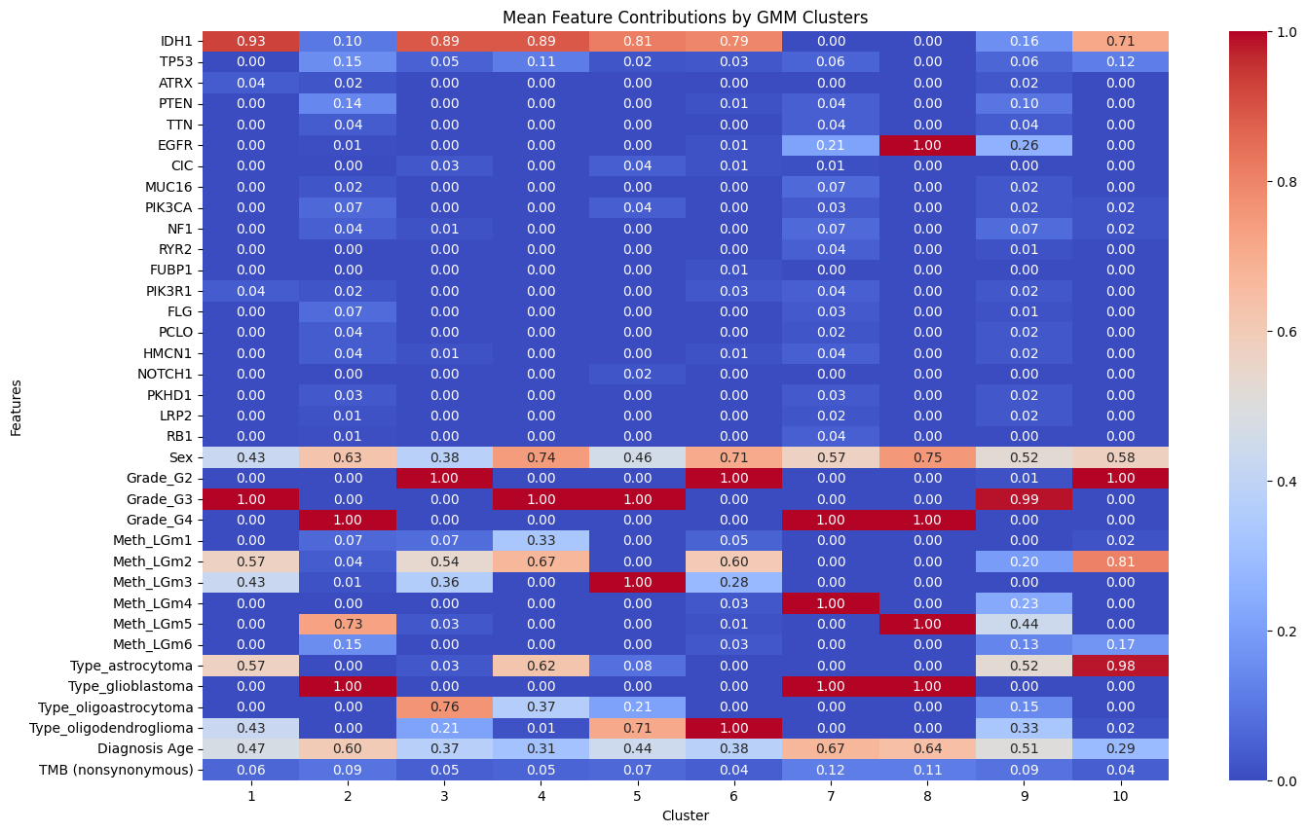
UMAP followed by GMM clustering
Notes:
Mann Whitney

Slide 13
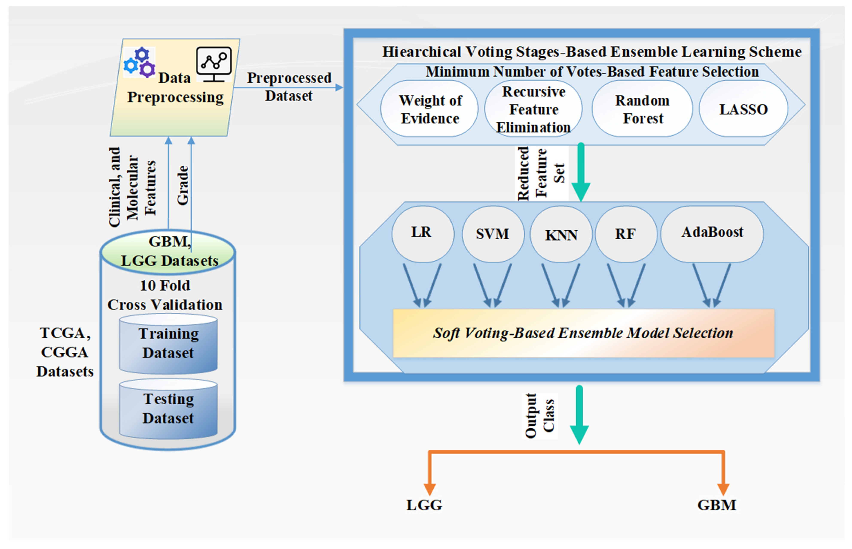
Molecular diagnostics using machine learning
Tasci et al., Int. J. Mol. Sci. 2022 https://doi.org/10.3390/ijms232214155
Notes:
Mann Whitney

Slide 14
Molecular diagnostics using machine learning
Feature selection:
Calculate sample weight (LGG 450, HGG 245)
Apply each feature selection method, combine selections with voting >=3
Final selected features: ['IDH1', 'TP53', 'PTEN', 'TTN', 'EGFR', 'CIC', 'MUC16', 'FUBP1', 'PIK3R1', 'FLG', 'PKHD1', 'RB1', 'Sex', 'Diagnosis Age', 'TMB (nonsynonymous)’]
Number of selected features: 15
Random Forest | CV Accuracy: 0.83 ± 0.02
SVM | CV Accuracy: 0.82 ± 0.05
KNN | CV Accurac: 0.80±0.05
AdaBoost | CV Accuracy: 0.82 ± 0.04
Logistic Regression | CV Accuracy: 0.83 ± 0.05
Ensemble Voting Classifier (5 models) | CV Accuracy: 0.84±0.04
Notes:
Mann Whitney

Slide 15
Molecular diagnostics using machine learning
Ensemble model 5
Accuracy | 0.84
Precision | 0.89
F1-Score | 0.79
ROC-AUC Score | 0.89
Classification Report
 | precision | recall | f1-score | support
LGG | 0.92 | 0.82 | 0.87 | 450
GBM | 0.73 | 0.87 | 0.8 | 245
accuracy |  |  | 0.84 | 695
Macro avg | 0.83 | 0.85 | 0.83 | 695
Weighted avg | 0.86 | 0.84 | 0.84 | 695
Notes:
Mann Whitney

Slide 16
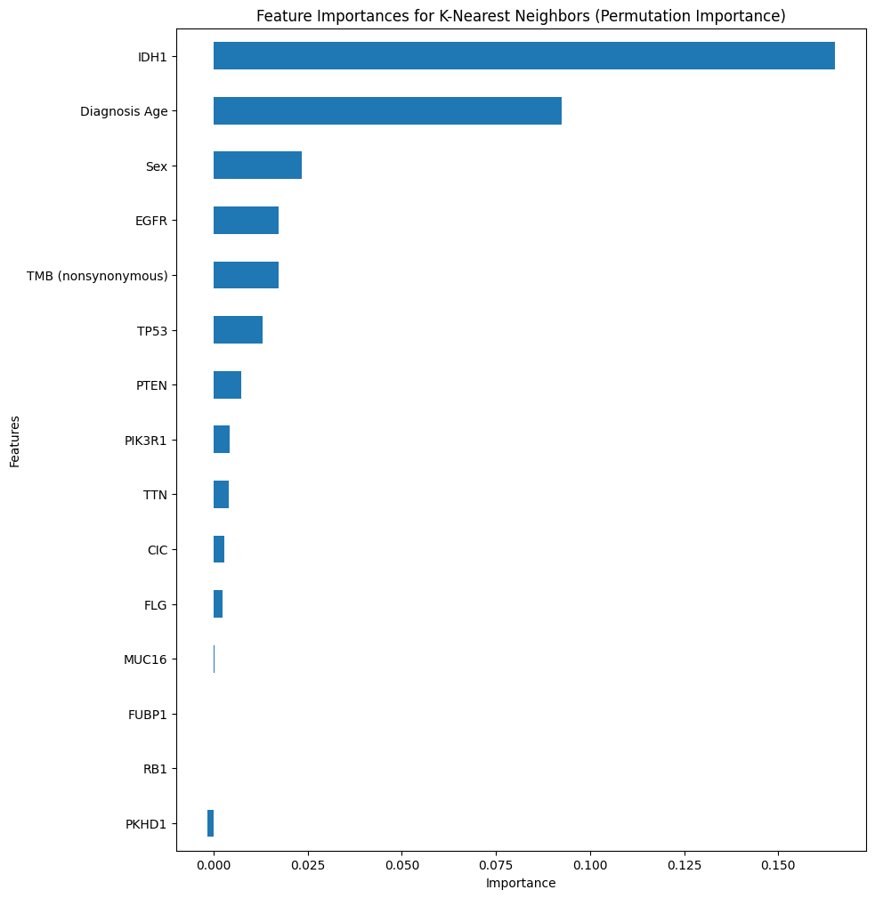
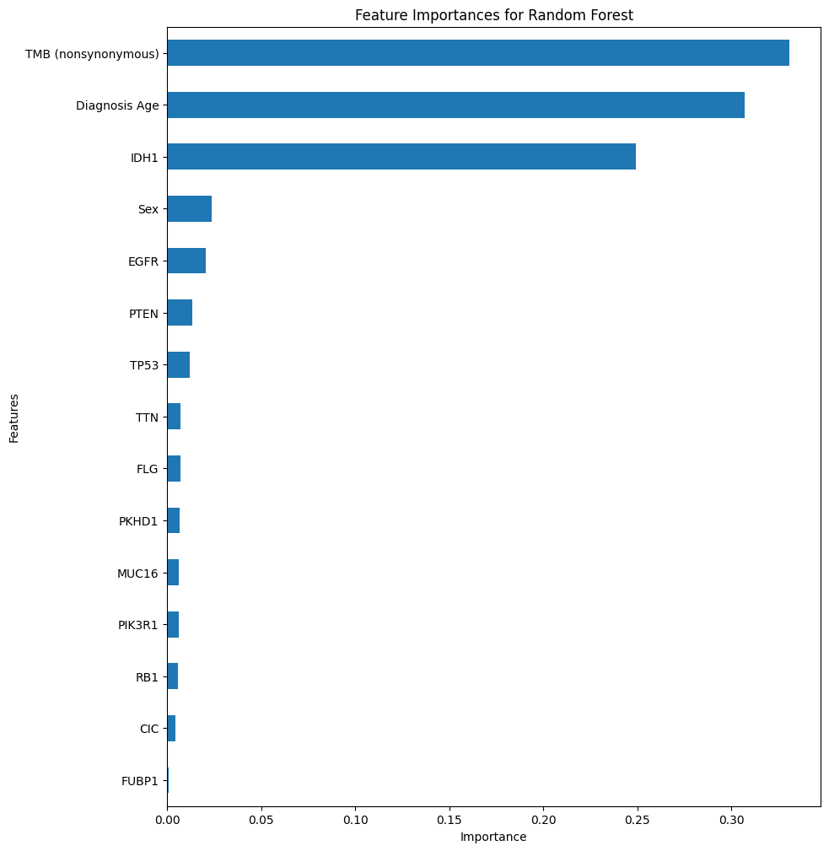
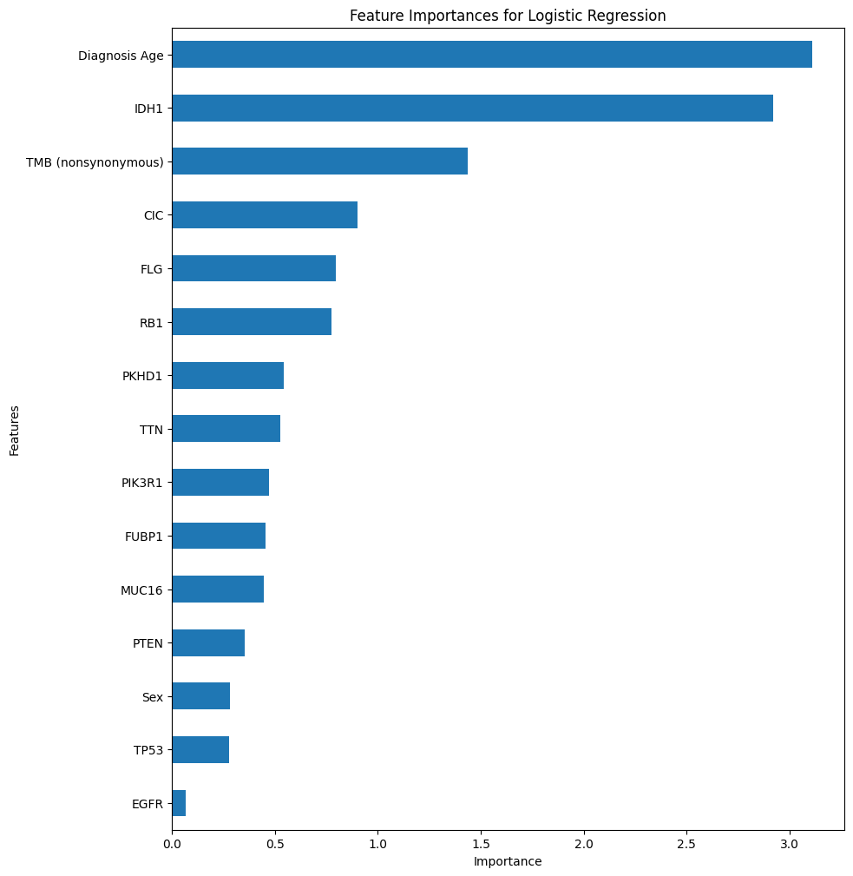
Molecular diagnostics using machine learning
Notes:
Mann Whitney

Slide 17
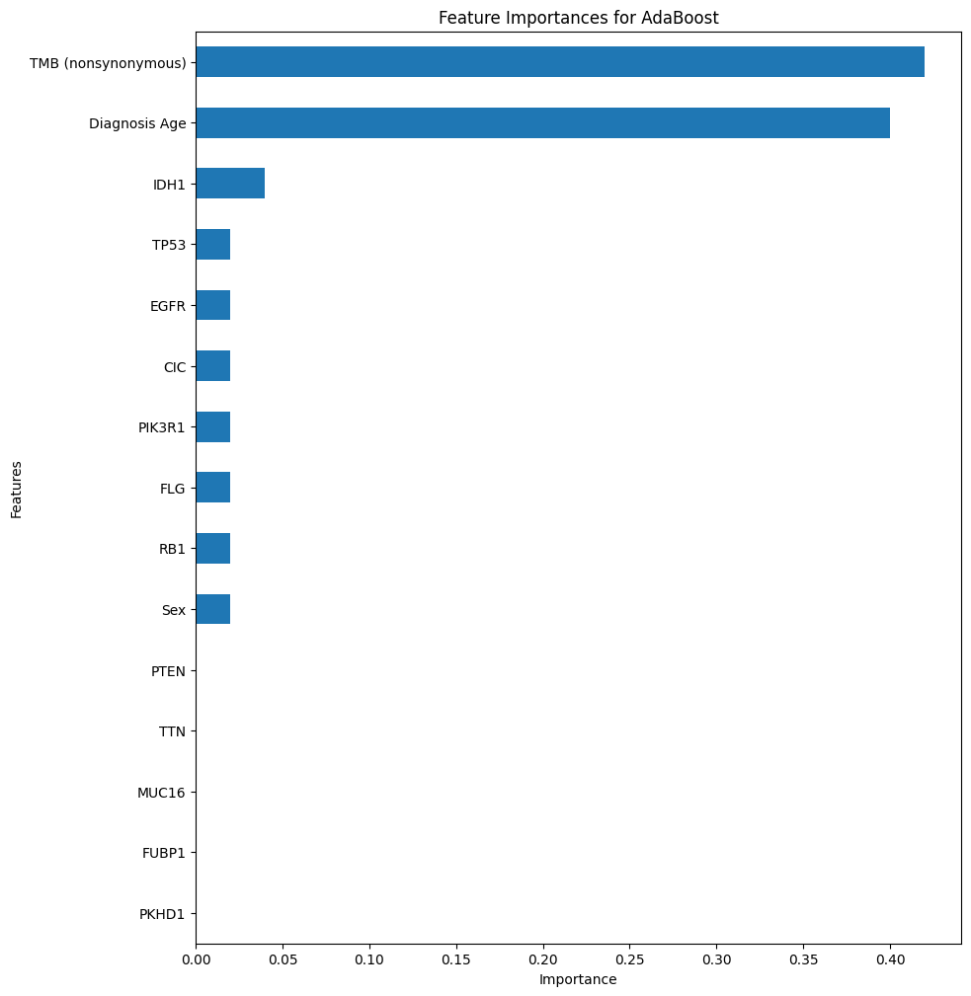
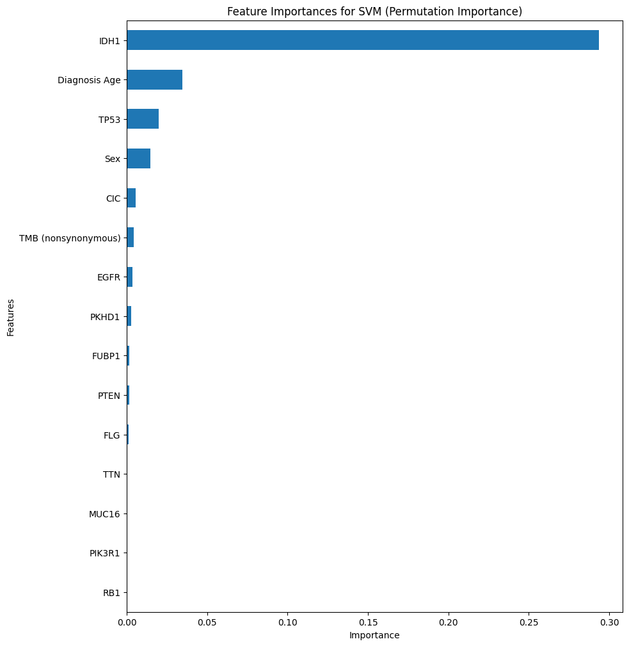
Molecular diagnostics using machine learning
Notes:
Mann Whitney

Slide 18
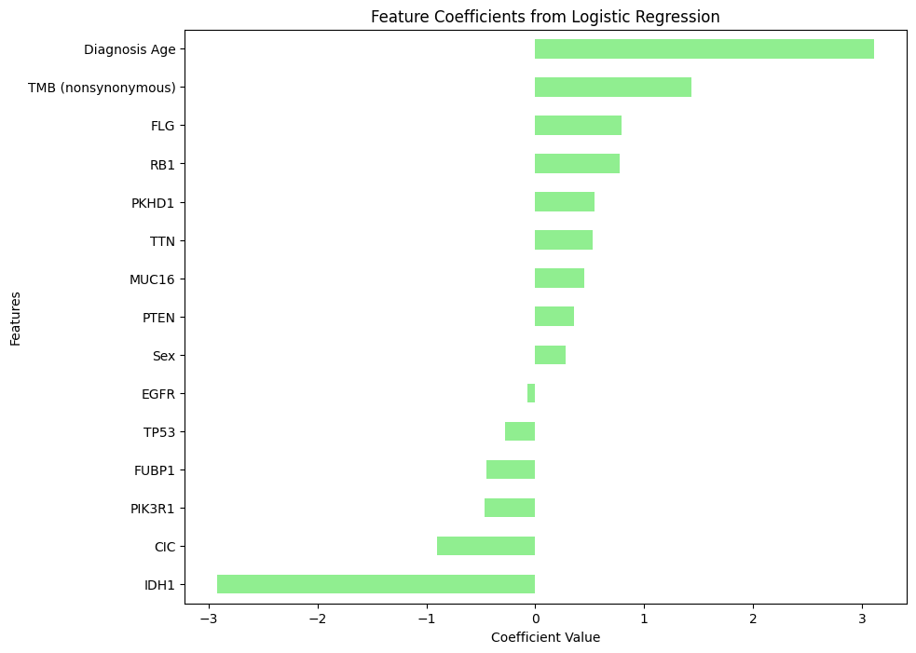
Molecular diagnostics using machine learning
Notes:
Mann Whitney

Slide 19
Molecular diagnostics using machine learning
Ensemble model 5 TCGA Validation set
Accuracy | 0.8367
Precision | 0.8308
F1-Score | 0.7976
ROC-AUC Score | 0.9130
Classification Report
 | precision | recall | f1-score | support
LGG | 0.84 | 0.89 | 0.86 | 487
GBM | 0.83 | 0.77 | 0.8 | 352
accuracy |  |  | 0.84 | 839
Macro avg | 0.84 | 0.83 | 0.83 | 839
Weighted avg | 0.84 | 0.84 | 0.84 | 839
Notes:
Mann Whitney

Slide 20
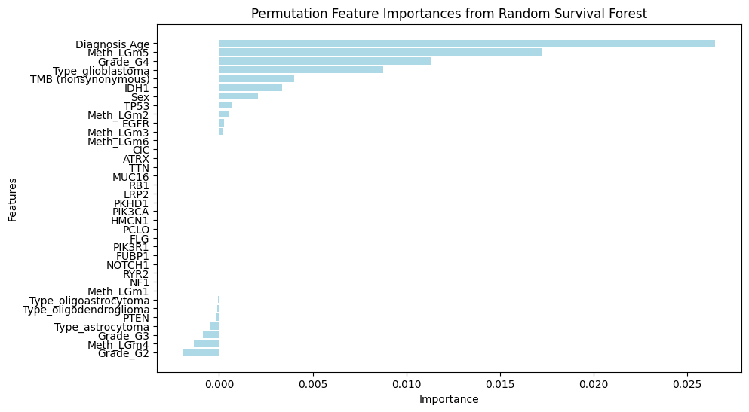
Survival prediction using machine learning
Training, validating, and calculating feature importances using permutation importance with the Random Survival Forest model: Concordance Index on Test Set: 0.8305
Features removed due to negative or zero importance:
'CIC', 'ATRX', 'TTN', 'MUC16', 'RB1', 'LRP2', 'PKHD1', 'PIK3CA', 'HMCN1', 'PCLO', 'FLG', 'PIK3R1', 'FUBP1', 'NOTCH1', 'RYR2', 'NF1', 'Meth_LGm1', 'Type_oligoastrocytoma', 'Type_oligodendroglioma', 'PTEN', 'Type_astrocytoma', 'Grade_G3', 'Meth_LGm4', 'Grade_G2’
Concordance Index on Reduced Test Set: 0.8379
Notes:
Mann Whitney

Slide 21
Survival prediction using machine learning
Feature selection:
Calculate sample weight (living 467, 6deceased 228)
Apply each feature selection method, combine selections with voting >=3
Final selected features: ['IDH1', 'Grade_G2', 'Grade_G4', 'Meth_LGm2', 'Type_astrocytoma', 'TMB (nonsynonymous)’+ 'TP53’]
Number of selected features: 7
Notes:
Mann Whitney

Slide 22
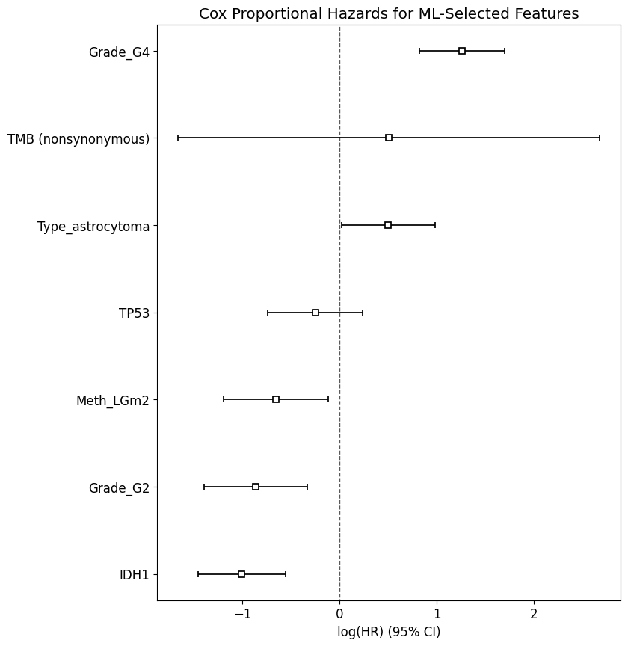
Survival prediction using machine learning
Cox proportional hazards model with features selected by ML
Notes:
Mann Whitney

Slide 23
Survival prediction using machine learning
Feature selection:
Calculate sample weight (living 467, 6deceased 228)
Apply each feature selection method, combine selections with voting >=3
Final selected features: ['IDH1', 'Grade_G2', 'Grade_G4', 'Meth_LGm2', 'Type_astrocytoma', 'TMB (nonsynonymous)’+ 'TP53’]
Number of selected features: 7
 | CV Accuracy
Random Forest | 0.70 ± 0.13
SVM | 0.62 ± 0.14
KNN | 0.70 ± 0.12
Gradient Boosting | 0.71 ± 0.16
Logistic Regression | 0.64 ± 0.15
Ensemble Voting Classifier (5 models) | 0.74 ± 0.16
Ensemble Voting Classifier (KNN,SVM, GB) | 0.73 ± 0.16
Notes:
Mann Whitney

Slide 24
Survival prediction using machine learning
Ensemble model 5
Accuracy | 0.74
Precision | 0.60
F1-Score | 0.61
ROC-AUC Score | 0.75
Classification Report
 | precision | recall | f1-score | support
Living | 0.82 | 0.79 | 0.81 | 467
Deceased | 0.60 | 0.64 | 0.62 | 228
accuracy |  |  | 0.74 | 695
Macro avg | 0.71 | 0.72 | 0.71 | 695
Weighted avg | 0.75 | 0.74 | 0.74 | 695
Notes:
Mann Whitney

Slide 25
Survival prediction using machine learning
Ensemble model 5 + undersampling
Accuracy | 0.72
Precision | 0.75
F1-Score | 0.73
ROC-AUC Score | 0.77
Classification Report
 | precision | recall | f1-score | support
Living | 0.74 | 0.69 | 0.71 | 228
Deceased | 0.71 | 0.76 | 0.73 | 228
accuracy |  |  | 0.72 | 456
Macro avg | 0.72 | 0.72 | 0.72 | 456
Weighted avg | 0.72 | 0.72 | 0.72 | 456
Notes:
Mann Whitney

Slide 26
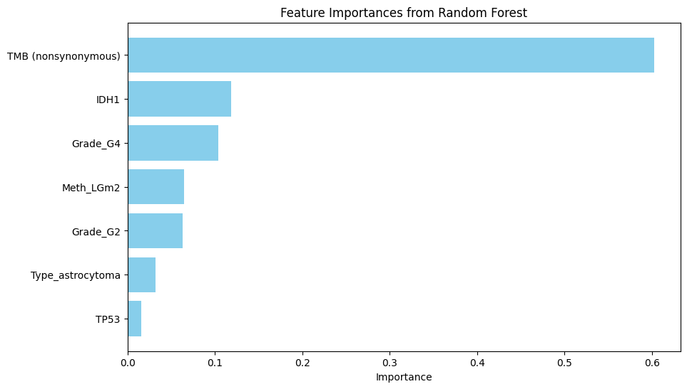
Feature importance
Notes:
Mann Whitney

Slide 27
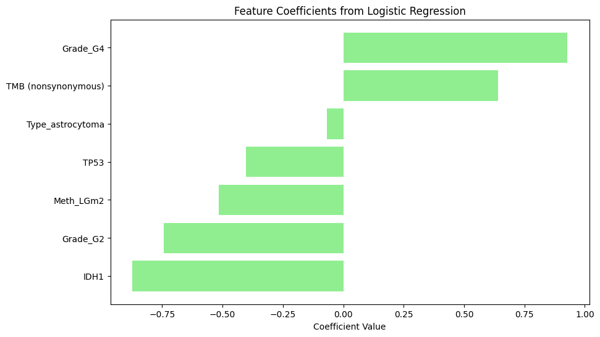
Feature importance
Notes:
Mann Whitney

Slide 28
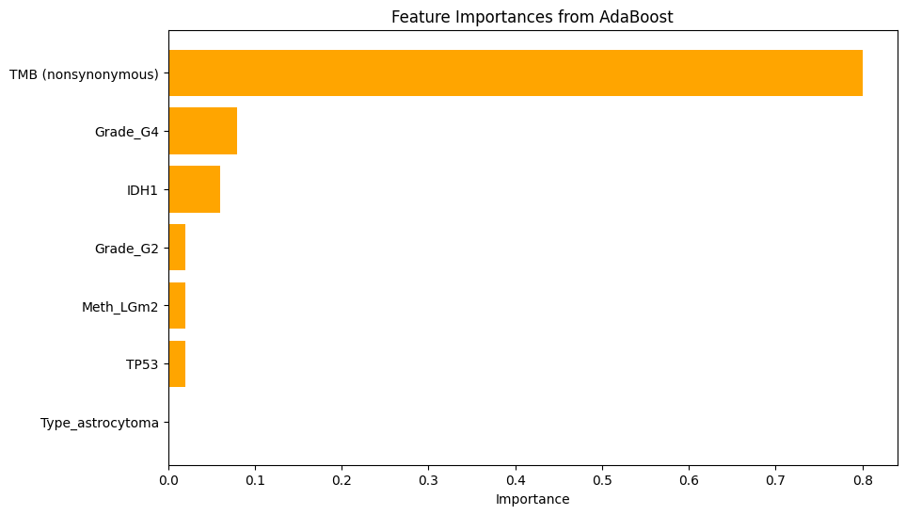
Feature importance
Notes:
Mann Whitney

Slide 29
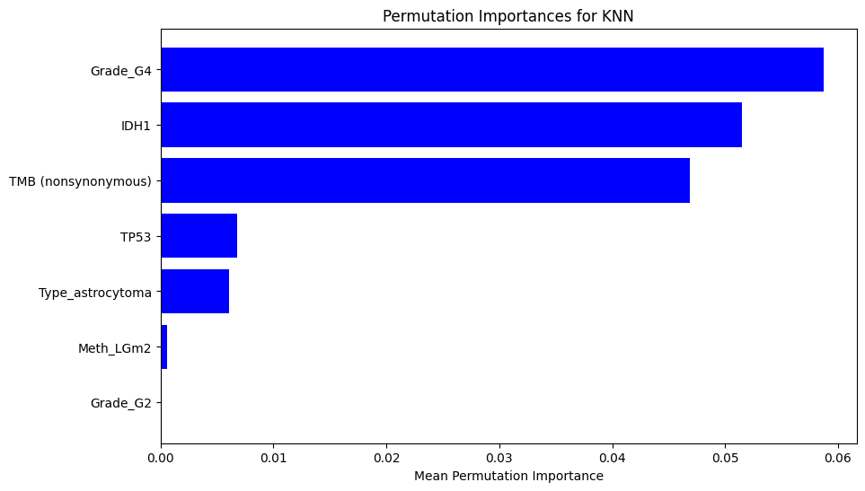
Feature importance
Notes:
Mann Whitney

Slide 30
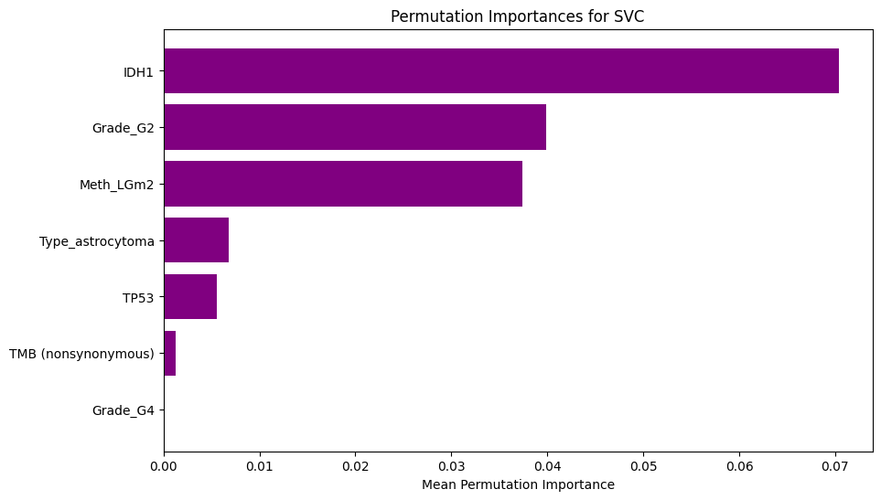
Feature importance
Notes:
Permutation importance for models like SVC or KNN shows how much the model relies on a feature by measuring the decrease in performance when that feature's values are shuffled. A high permutation importance indicates that the feature is crucial for the model's predictions but does not show the direction of the effect (positive or negative).

Slide 31
Conclusions
Molecular features important for clustering are IDH1 mutation status, Methylation pattern, EGFR mutation status
The hierarchical voting-based methodology works well for diagnosis prediction and less well for survival prediction
The main feature for survival prediction is Age at diagnosis, followed by IDH mutation status, Methylation pattern, WHO grade and TMB

